Slide 1
Information for Presenters
Build the project and bring it with you to the presentation so that you can demo it live. The project write up can be found on Hackster.io.
Each slide contains speaker notes; please review prior to presenting.
You can ‘localize’ the Face API slides by replacing the faces used in the examples. The Microsoft Cognitive Services website has several different faces available for the various API explanations.
On Slide 12, there is a link away to the Microsoft Cognitive Services website to run the online Face Detection demo. The demo is even more impressive when you use your own photos. So, before the presentation starts, take a few photos of people in the audience (with their permission), put them on your laptop, and try out the demo to make sure the photos work well.
When running the live demo of the Dorm Room Monitor project, it’s much easier to have your whitelist already created – make sure that you are in it and add 4 to 5 photos of your face using different angles in order to aid the facial recognition process.

Slide 2
Build an Intelligent Security System
Welcome your friends; know your foes.
<name>
<title>

Slide 3
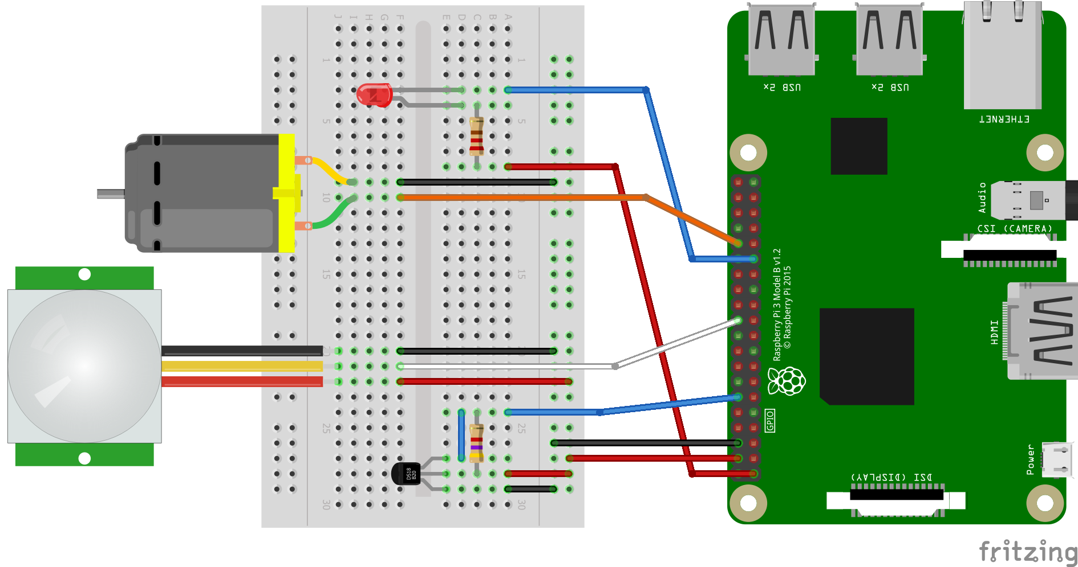
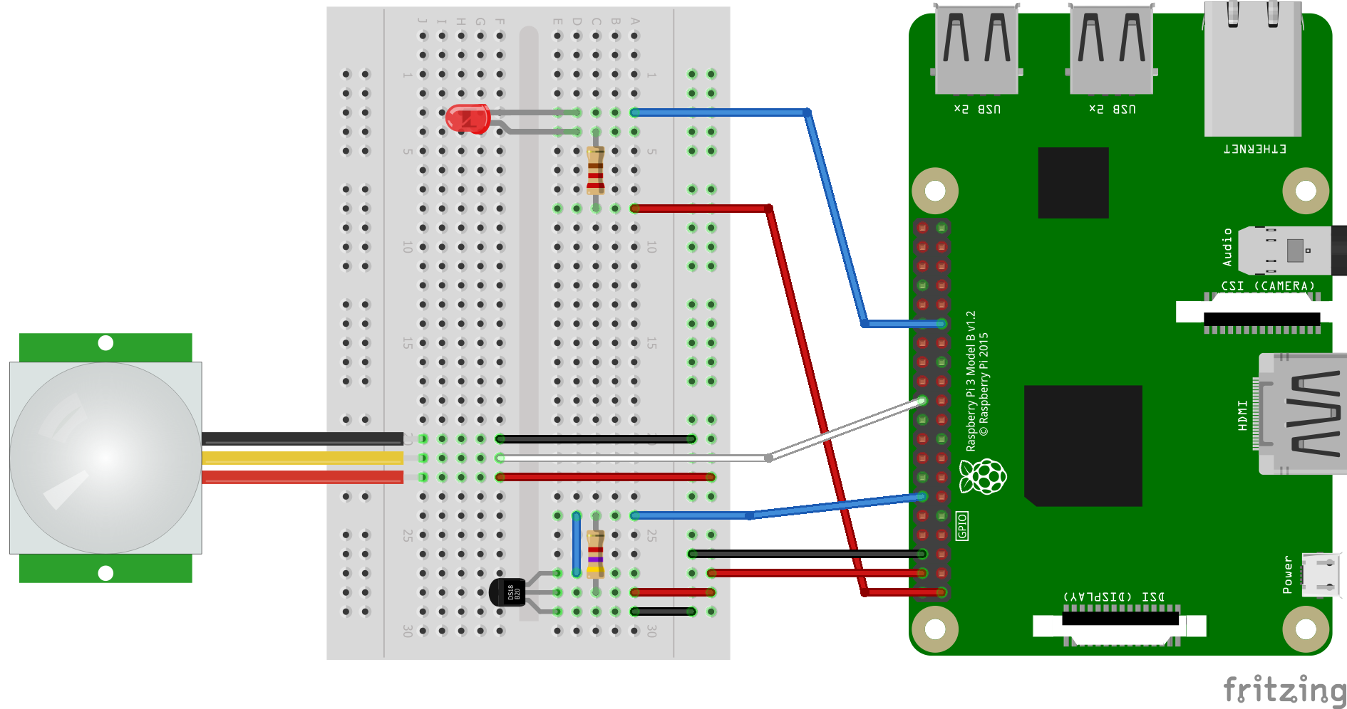
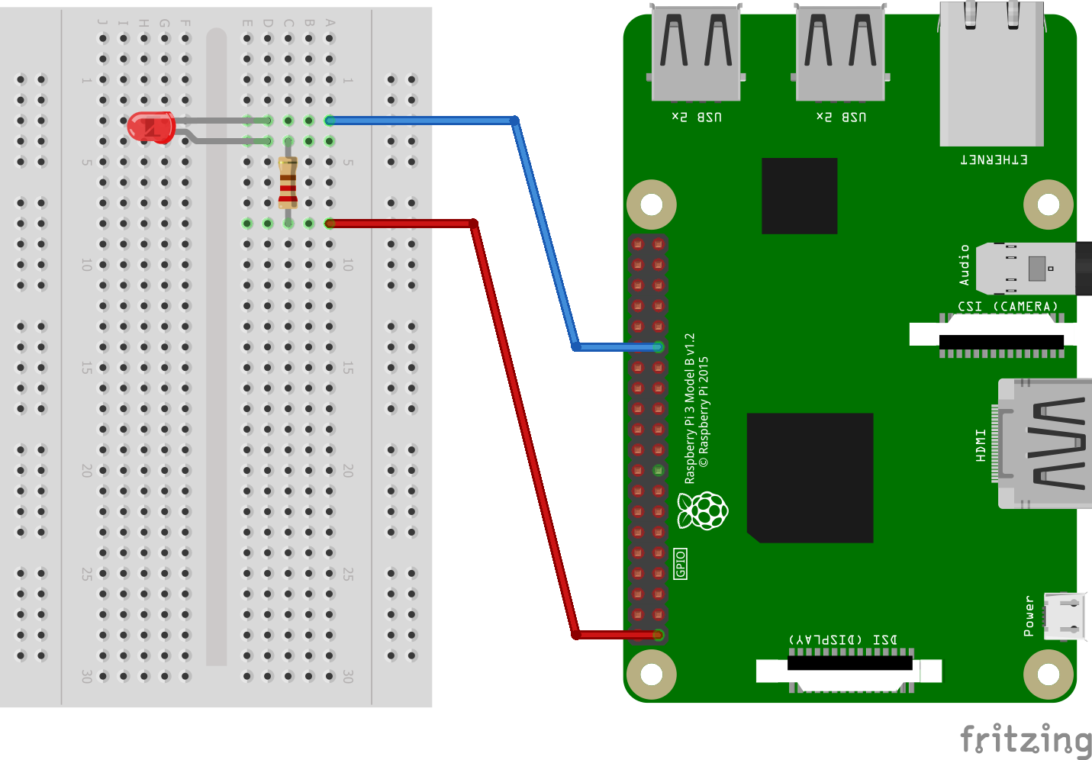
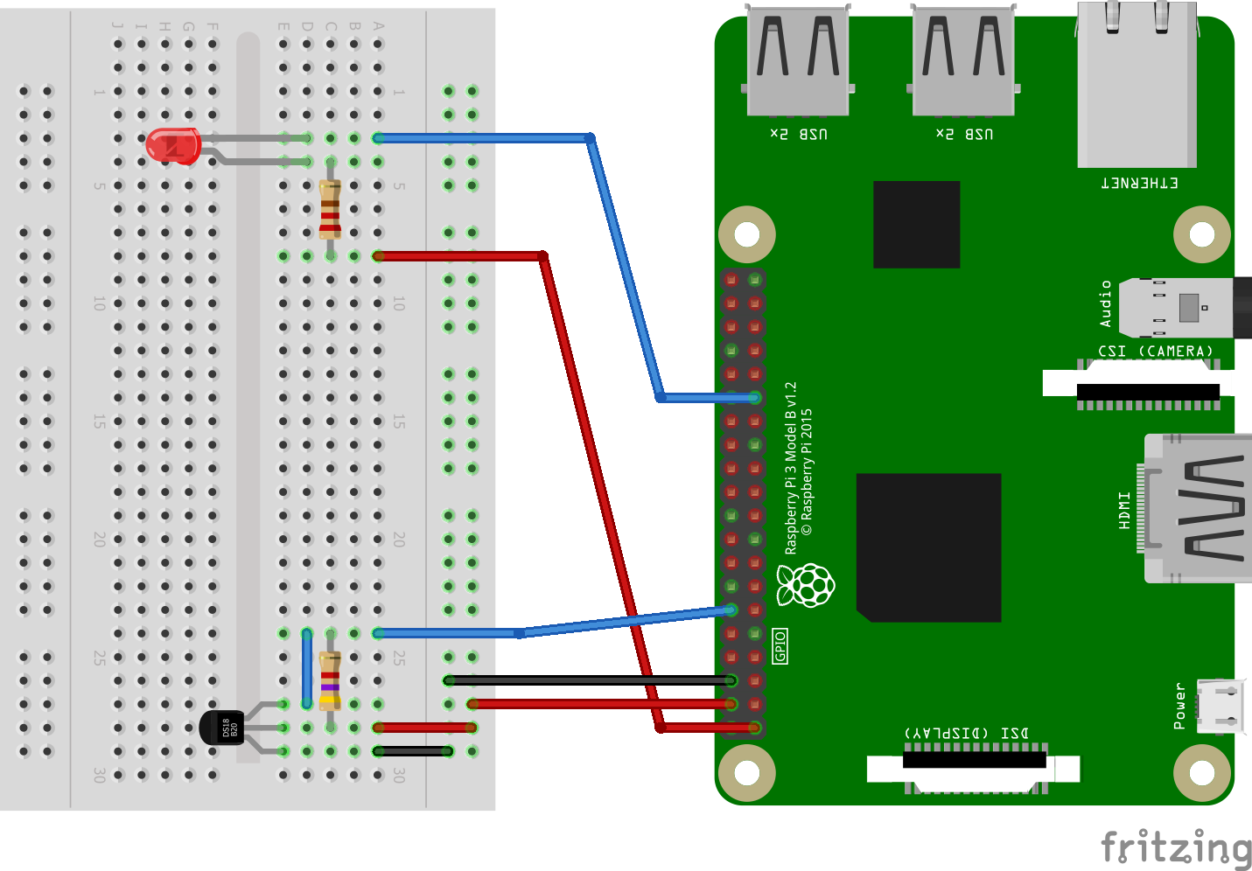
New to the internet of things? Let’s skip beyond Blinky…
Notes:
Don’t get me wrong, Blinky IS the place to start. And most of us got satisfaction from getting Blinky to work for the first time. Next, you probably added a temp sensor or something similar to blink the LED based on environmental factors. A motion sensor. Maybe you even added a fan to make things a little more practical – when the room gets above a preset temp, turn on the fan. This is all well and good as we have to learn the basic building blocks of working with hardware. But, with the platform capabilities we have at our disposal, we can do so much more – like adding cognitive services to our project.

Slide 4
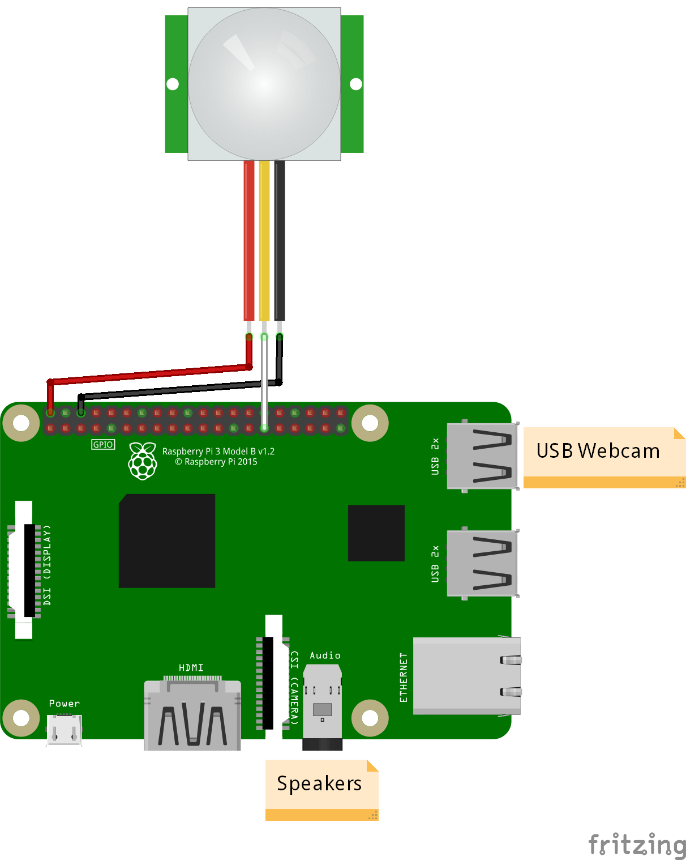


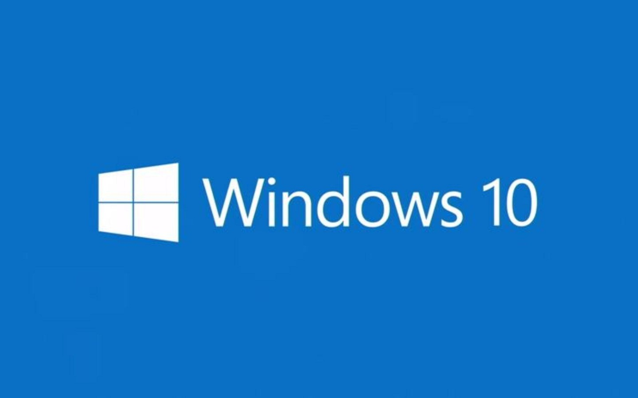


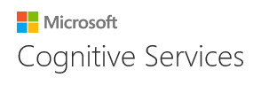
…let’s build an Intelligent Security System
4
Photo is taken
5
Face is analyzed
3
Alarm is sounded
1
Person enters room
2
Motion is detected
6a
Recognized person is welcomed
6b
Image of unrecognized person is saved
Notes:
Here is an example of adding intelligence to your project. Dorm Room Monitor is a “smart” security system. What makes it “smart”? It utilizes facial recognition to distinguish between people who are approved to be there and those that aren't; if the person is recognized by the security system, he or she is welcomed into the room. If the person isn't recognized, a photo of the intruder is stored in the system for the room owner to review later.
(Now, demo the actual project you built live.)

Slide 5
Project breakdown
Build your security system

Slide 6

Take It One Step At A Time
Assemble your hardware
Subscribe to cloud services
Develop your app
Notes:
Even though it may seem a little daunting at first, the dorm room monitor project isn’t very complicated – you just have to take it one step at a time. Break the project down and attack one part at a time.
First, start with your hardware. This is where you projects starts – from the microcomputer to, in this case, the camera and sensors. Your device hardware dictates what your overall projects capabilities can be. Or, more correctly, determine what your project’s needs are and then select the hardware that’ll support those needs.
Next, get your cloud services setup. In this case, you will need a subscription to Microsoft Cognitive Services and the Face API.
Then develop your app. Your app is what ties it all together and connects your device to the cloud.
Also, keep in mind is that you aren’t creating all of this from scratch. The vast majority of the underlying code in this project – platform services, libraries, hardware integration, etc - was written by lots of different people. You are reusing it; you are taking many building blocks and arranging them in a new way. You just have to write a little bit of code to tie all those components together. This orchestration of reusable components developed by other is now the norm in software development.
You’ll note that this general architecture of device / hardware and cloud services with an application to connect it all is the blueprint of Internet of Things solutions. Devices to interact – sense and or actuate – with the physical world. And app to connect that “basic” device to the cloud, and the cloud to make sensor of the world that the device is interacting with.

Slide 7
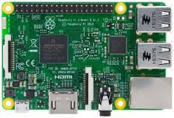
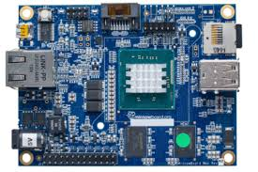
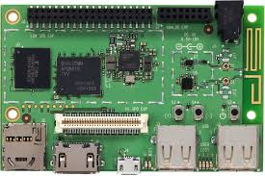
Different Boards for Different Applications
Raspberry Pi
MinnowBoard Max
DragonBoard 410c
US$35
US$99
US$75
Notes:
Before we go on, just a quick word about microcomputer choices. That’s right “choices” because Windows IoT Core is supported on multiple single board computers. This project was built on a Raspberry Pi 3. But it could also run on other boards – unmodified. I chose the Raspberry Pi 3 because it is easy to get and it’s relatively inexpensive. You might want to consider either of the other two boards if you have a graphics intense project and therefore need to take advantage of the GPU support. In fact, for this project, if you run it on a DragonBoard for instance, you would see the live video feed from the webcam in the UI.
As mentioned earlier, the needs of your project (or IoT solution) will really drive your hardware requirements and therefore what board you choose.
Speaker: You can localize this slide with the costs of the boards in your location.

Slide 8
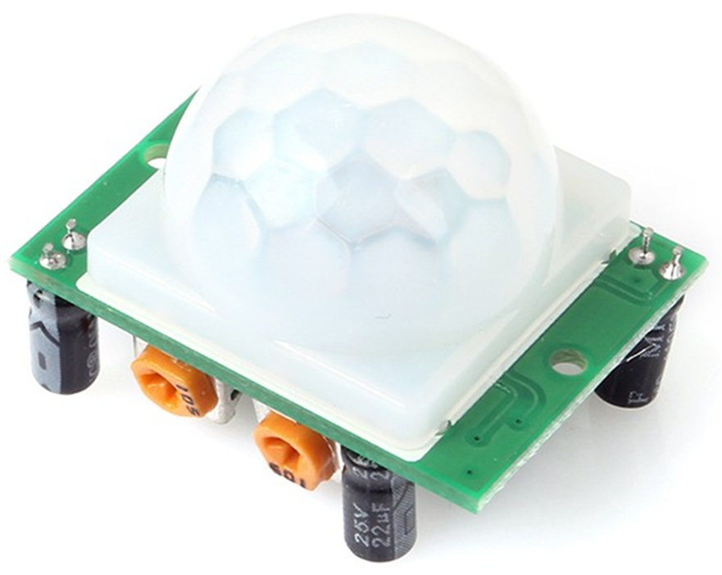
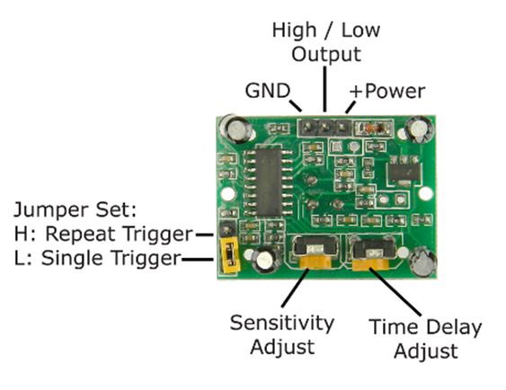
Wiring Up Your Hardware
Notes:
The starting point for our project is the hardware / the device to interact with the physical world. Depending on your project, the heart of the device will be a microcontroller or microcomputer to which you’ll wire up the sensors and other components to it. This project needed something with more computer power and memory so we choose the Raspberry Pi 3 microcomputer.
Let’s start with the PIR sensor.
It’s always best to check the sensor’s datasheet before wiring it up. But, most PIR sensors have the pin configuration shown here. The PIR sensor works at 5v power so connect its power pin to any of the 5v pwr pins on the Raspberry Pi. Connect GND to GND. The middle pin on the PIR is the signal pin – high when motion is detected and low when it is not. This pin needs to be connected to any of the Pi’s GPIO pins – in the case of the Dorm Room Monitor project, it was connected to GPIO 5.
There are two trim pots on the sensor – one to adjust sensitivity and one to adjust the time delay. Several factors play into sensitivity but for the most part, you can equate it to range. The time delay specifies how long motion needs to occur in order to be considered a detection - i.e. if you have a long time delay, motion that lasts a fraction of the second won't be reported. I generally leave these in the middle but you can play around with them to suit your environment.
The jumper is important as it allows you to select single trigger or repeat trigger modes. The Single Trigger setting will trigger the application when someone enters the room but won’t trigger again while he/she continues to be in the room - basically it remembers that someone is in the room and doesn't count their continuous motion as a new detection. The Repeat Trigger on the other hand sends a trigger to the app whenever it detects motion regardless of whether or not it detected motion the last time it took a reading.
As for the webcam and microphone, those just plug directly into the Raspberry Pi’s USB port and audio jack.

Slide 9
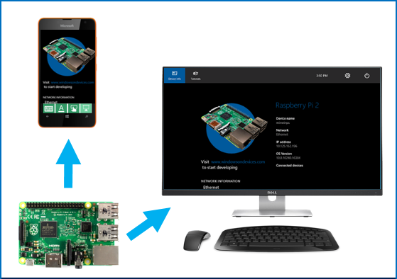
Simplify Your Hardware Setup
Remote display allows you to view and control your Windows 10 IoT Core UWP applications remotely, from a Windows 10 desktop PC, tablet, or phone.
Put a display on every displayless device.
Use local touch, keyboard, and mouse to interact with remote device.
Inter-device communication with no extra developer work.
Notes:
As with any technical project, the simpler the better. That not only applies to your code but also your environment. Another cool feature of the Windows platform is the Remote Display. Essentially, you are remoting out the input / output from a single board computer – i.e. Raspberry Pi – to a full Windows machine. You can use the display and keyboard/mouse from the full Windows machine to interact with your app on the Raspberry Pi. This comes in very handy – I don’t know about you but I don’t have external keyboards and monitors hanging around anymore – it’s just my laptop. This really limited the input options for my app - not anymore with Remote Display.

Slide 10
Project breakdown
Add intelligent cloud services
Notes:
Now that we have all the hardware assembled, let’s move to the cloud. Regardless of how much or how little computing power you have in your device, the cloud adds a significant amount more to your project – the capabilities are almost endless. And, what’s more, you get these high value, computationally expensive services for pennies. For this project, we are using the Face API; it’s just one part of Microsoft Cognitive Services which run on Azure.

Slide 11
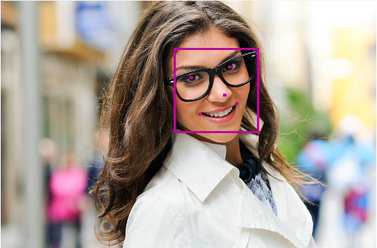
Microsoft Cognitive Services: Face API
"faceId": "48cdf8c8-841c-4d33-b875-1710a3fc6542",
"faceRectangle": {
"width": 228,
"height": 228,
"left": 460,
"top": 125
},
…
"faceAttributes": {
"age": 23.5,
"gender": "female",
...
"smile": 0.998,
…
"glasses": "ReadingGlasses"
https://www.microsoft.com/cognitive-services/en-us/face-api
Notes:
The Face API (https://www.microsoft.com/cognitive-services/en-us/face-api) is more than just facial recognition. At it’s core, it can detect faces in an image. In addition to detection the face and returning it’s location within the image, the face detection service will also return attributes about the face including gender, age, expression, etc. In this case, it even identified that the person is wearing glasses.
(Scroll down to the Face Detection demo. Use you own photos from your laptop to run the demo. Ideally, you took a few photos of people in the room (with their permission) before the Tech Talk so that you could load the photos on your laptop for the demo.)
Let’s take a look at the Face Detection service in action. There is a live demo on the Microsoft Cognitive Services website. We’ll even use our own photos.

Slide 12
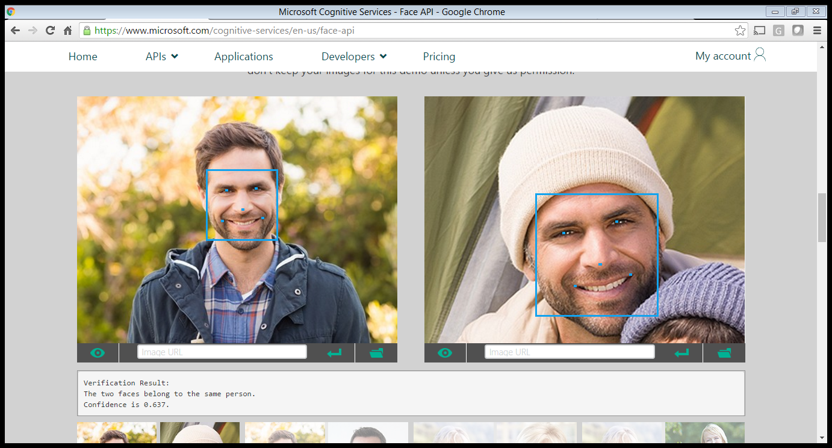
Face API – Face Verification
Verification Result:
The two faces belong to the same person.
Confidence is 0.637.
Notes:
The face verification service checks the likelihood that two faces belong to the same person.

Slide 13
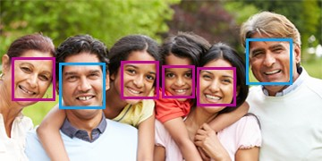

How Face API works
Identify a previously unseen face by trying to match against a set of known faces.
Each person in the group of known people have one to many faces associated with him or her.
The identity of any matching faces is returned.
Notes:
Face identification is equivalent to what is generally considered facial recognition. A group of people – with each person having one to many images – is provided upfront. After a person group has been created and trained, identification can then be performed against the group with a new test face. If the face is identified as a person defined in the group, the person will be returned.

Slide 14






Additional Cognitive Services
Vision
Language
Speech
Others:
Computer Vision
Emotion
Video
Spell Check
Linguistic Analysis
Text Analysis
Bing Speech
Custom Recognition
Speaker Recognition
Knowledge (Academic, Recommendations)
Search (Autosuggest, Images, News, Video)
https://www.microsoft.com/cognitive-services/en-us/apis
Notes:
In addition to the Face API we just discussed, there are several other vision oriented cognitive services as well as speech oriented services. Beyond vision and speech, there are cognitive services for language, knowledge, and search.
Computer vision is able to analyze image, recognize celebrities, read text in images, and generate thumbnaisls.
Emotion API analyzes facial expressions in images and videos and returns an aggregate summary of their emotions.
Video API is able to stabilize video, detect and track faces, detect motion, and create a video thumbnail.
Bing Speech API processes speech to text and text to speech but also speech intent.
Custom Recognition API enables you to define custom language and acoustic models to improve the recognition results.
Speaker Recognition API can perform speaker verification and speaker identification.
Remember, all this is running on Azure. Azure is more than just cloud infrastructure. It also provides higher level services – ones which require a lot of processing – which can greatly augment the power of your target device.

Slide 15
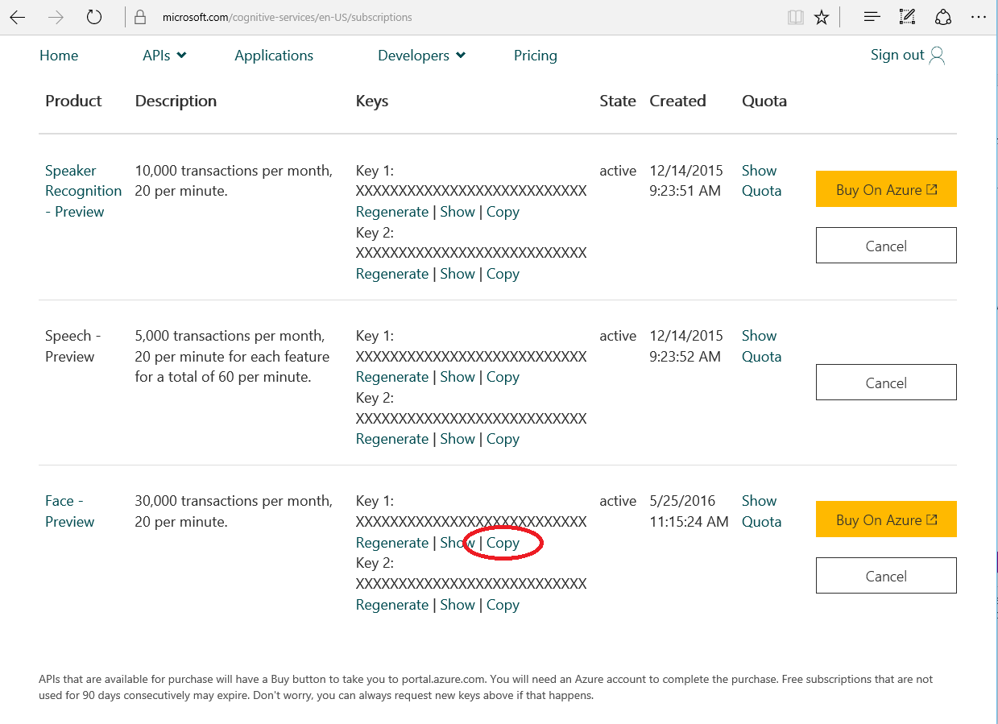
Sign Up For Free And Get Your API Key
https://www.microsoft.com/cognitive-services/en-us/sign-up
Notes:
You can sign up for free for Microsoft Cognitive Services. The transaction limits and request frequency at the free pricing tier are more than enough for this project. Go to https://www.microsoft.com/cognitive-services/en-us/sign-up to sign up. Then, you will be able to specify the different services you want to subscribe to and accept the terms and conditions. At that point, you will be taken to this page – it shows all the services you have subscribed to. This project only uses the Face API. But, as you can see here, I have additional services that I have used for other IoT projects; free access isn’t limited to a single service.

Slide 16
Project breakdown
Tying it all together with an app
Notes:
So far, we’ve assembled our hardware and subscribed to Microsoft Cognitive Services on Azure. Now it’s time to develop our app to tie it all together.

Slide 17
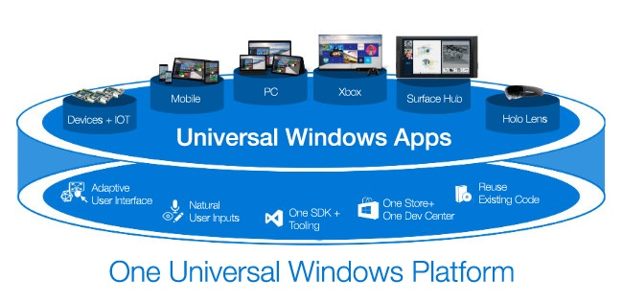
IoT / Mobile / Desktop – It’s All One App
Universal Windows Platform (UWP) provides a common app platform available on every device that runs Windows 10.
The UWP core APIs are the same for all Windows device families.
Extension SDKs add specialized APIs for each device family.
UI elements use effective pixels, so they automatically adapt themselves based on the number of screen pixels available on the device.
Use Xamarin to easily extend your C# app cross-platform to Android and iOS
Notes:
For the app, I chose the Universal Windows Platform (UWP).
The Universal Windows Platform allows you to write a single application and run it – unaltered – across the spectrum of Windows devices. For example, the dorm room monitor project is a UWP app – it can run on your laptop as well as the Raspberry Pi without any modifications. The core APIs for thing like using the webcam, storing images and manipulating files, rendering the UI, and many more are the same across all the platforms. The only thing that’s different on the Raspberry Pi are the GPIO pins so the project has code to handle the absence of GPIO pins gracefully. And there is a button in the UI to manually trigger motion in that case.
The other benefit of the Universal Windows Platform is that the skills you develop building this project are 100% transferrable to the creation of a desktop app or a mobile app. You’ll reuse your knowledge of C# and Visual Studio time and time again – both while in school and during your career.

Slide 18
Set-up the GPIO Pins
// Get the GpioController
gpioController = GpioController.GetDefault();
if (gpioController == null)
{
// There is no Gpio Controller on this device so return false.
return false;
}
// Open the GPIO pin that interacts with the PIR sensor
pirSensor = gpioController.OpenPin(GpioConstants.PirPin);
if (pirSensor == null)
{
// Pin wasn't opened properly so return false
return false;
}
// Set the direction of the PIR sensor as input
pirSensor.SetDriveMode(GpioPinDriveMode.Input);
Windows.Devices.Gpio namespace adds several classes for working with the device’s GPIO pins
Get a GPIO controller.
Open the pin.
Set the pin’s mode or direction.
Notes:
Now, let’s dive into the main parts of the code. First, let’s setup the GPIO pins so that we can get information from the PIR sensor.
The general process if the same across all platforms and language – define a pin and then set it as an input or output. For Windows, there is a new namespace – Windows.Devices.GPIO – that adds several classes for working with the hardware device’s GPIO pins. You first need to get a GPIO controller. Not all hardware supports GPIO – i.e. your laptop or Windows phone. So, if you are writing a true UWP app that can run on multiple platforms, then check the value of the controller to determine whether or not the current platform supports GPIO. Then, create your pin object for each GPIO pin you are going to use. And, finally, since GPIO pins can be used to read a voltage (i.e. data) from connected sensors or devices (in input mode) or to write data to connected actuators or devices (in output mode), the direction of the pin needs to be defined.
https://msdn.microsoft.com/library/windows/apps/windows.devices.gpio.aspx

Slide 19
Using Interrupts
public void InitializeGpio()
{
...
// If initialization was successful, attach motion sensor event handler
if (gpioAvailable)
{
gpioHelper.GetPirSensor().ValueChanged += PirSensorChanged;
}
}
private async void PirSensorChanged(GpioPin sender, GpioPinValueChangedEventArgs args)
{
...
// Checks if event was triggered from an entry (rising edge)
// or exit (falling edge)
if (args.Edge == GpioPinEdge.RisingEdge)
{
//motion sensor was just triggered
...
await SomeoneEntered();
The GpioPin class has an event for pin interrupts.
For an input pin, the event occurs when the pin’s value changes due to external stimulus.
The event will be triggered on each pin change so while you are processing a trigger, it may trigger again.
Notes:
Now that we have the PIR sensor connected to a GPIO pin, we need a way to know when it detects motion – when it’s signal pin goes from low to high. You can either continually poll the pin state or you can use a hardware interrupt. A hardware interrupt triggers an event only when the state of the pin changes. So, instead of polling for changes, the app does nothing as long as the PIR sensor isn’t triggered. As soon as it is, the interrupt fires an event at which time the state of the PRI pin is checked. If necessary, you can also determine whether the pins change is from low to high (someone entered the room in the case of our PIR sensor) or high to low (someone exited the room).
I used the motionJustSensed boolean to manage repeat triggers – i.e. to esnsure that I finish processing one trigger completely before starting the next.

Slide 20
Webcam Initialization
...
// Attempt to get attached webcam
var cameraDevice = await FindCameraDevice();
// Creates MediaCapture initialization settings with found webcam device
var settings = new MediaCaptureInitializationSettings { VideoDeviceId = cameraDevice.Id };
mediaCapture = new MediaCapture();
await mediaCapture.InitializeAsync(settings);
...
private static async Task<DeviceInformation> FindCameraDevice()
{
// Get available devices for capturing pictures
var allVideoDevices = await
DeviceInformation.FindAllAsync(DeviceClass.VideoCapture);
if (allVideoDevices.Count > 0)
{
// If there is a device attached, return the first device found
return allVideoDevices[0];
...
}
.NET framework provides all the capabilities necessary to utilize a webcam
Find all video capture devices.
Return the first one found.
Initialize the media capture device with the settings from the webcam.
Notes:
Because we are building an Universal Windows Platform app, we can take advantage of all the Windows core services – including adding a webcam to our app. It’s just a few lines of code to define the webcam – instantiate a new media capture object and then assign it the settings for whatever camera was detected on the device. That’s it.

Slide 21
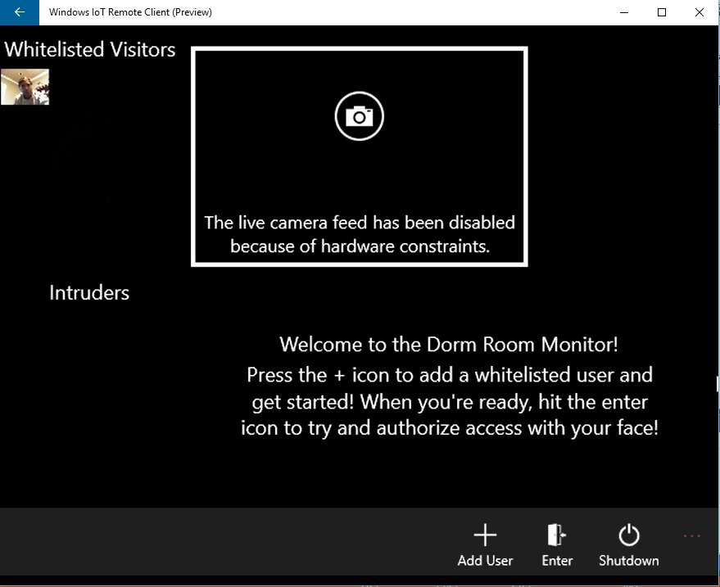
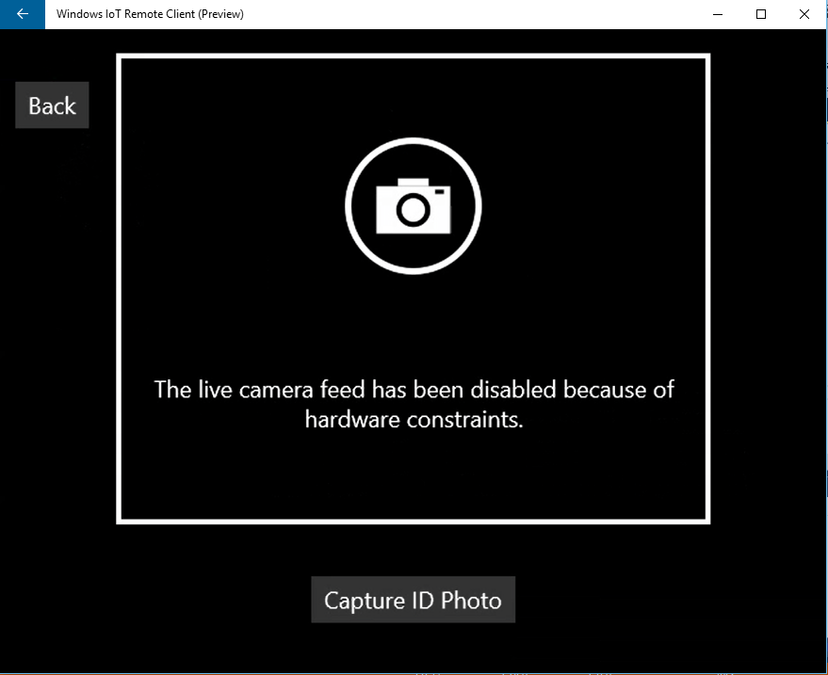
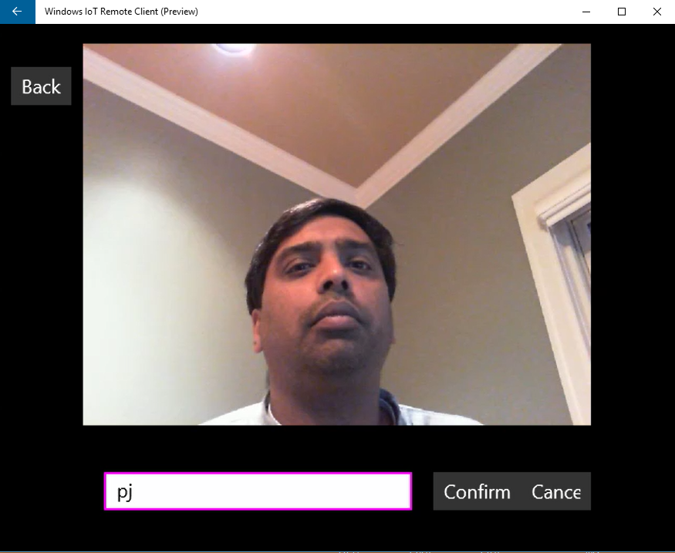
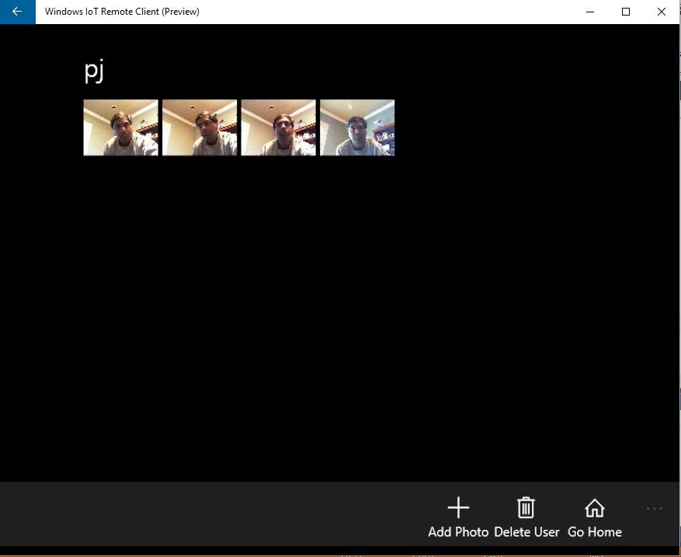
UI Flow
Notes:
As we saw in the demo, the app has several screens. The main screen shows the white listed people in the top left and the intruders in the bottom left. Clicking on the Add User button in the bottom button bar will take you to a screen to add a user to the white list. Click the Capture ID Photo button to take a picture of the person. Then, enter the person’s name a click confirm to add him/her to the whitelist.
Ideally, you will have more than one photo for each person on the whitelist. To add more photos, click on the person’s photo in the Whitelisted Visitors section on the main page. Then click the add photo button to take additional photos of the person. The new photos will be added to the whitelist and included in the training process.
Again, because we are building an UWP app, we take advantage of all the Windows platform UI building blocks and Visual Studio’s toolset for UI development.
Presenter – Take some screenshots of the Remote Display on your dev machine when you get the app up and running to personalize these UI images.

Slide 22
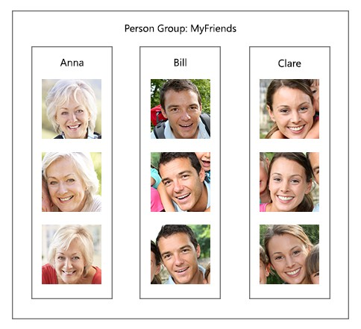
How To Identify a Face
Step 1 – Create a Person Group
Step 2 – Define Persons in the Group
Step 3 – Add Images For Each Person
Step 4 – Train the Person Group
Step 5 – Identify a Face
Notes:
https://www.microsoft.com/cognitive-services/en-us/face-api/documentation/Face-API-How-to-Topics/HowtoIdentifyFacesinImage
Before getting into the Face Identification code, let’s first take a look at the process.
Step 1: The person group is the collection of known persons. The identification process is run against a specific person group.
Step 2: The person group is comprised of one to many persons. A person is a basic unit of identification.
Step 3: Add images to each person in the person group. Images from different angles with different backgrounds / colors are best.
Step 4: The person group must be trained before an identification can be performed using it.
Step 5: When performing identify, the Face API can compute the similarity of a test face among all the faces within a group, and returns the most comparable person(s) for that testing face.

Slide 23
Using the Restful Face – Identify API
Create a person group:
Create a person:
Detect the face:
Add a person face:
Train person group:
Identify person:
https://api.projectoxford.ai/face/v1.0/persongroups/{personGroupId}
https://api.projectoxford.ai/face/v1.0/persongroups/{personGroupId}/persons
https://api.projectoxford.ai/face/v1.0/detect[?returnFaceId][&returnFaceLandmarks][&returnFaceAttributes]
https://api.projectoxford.ai/face/v1.0/persongroups/{personGroupId}/persons/{personId}/persistedFaces[?userData][&targetFace]
https://api.projectoxford.ai/face/v1.0/persongroups/{personGroupId}/train
https://api.projectoxford.ai/face/v1.0/identify
Notes:
The Microsoft Cognitive Services are platform and language independent. You can pretty much use any technology you want and interface with the service via Restful APIs.
By identify, we are talking about the process of detecting the face in the image AND comparing it to a set of known faces to find a match.
There is a restful interface to the Face API.
Step 1: create a person group (http put)
Step 2: create a person (http post)
Step 3: detect a face (http post) – the face must first be detected in the image because the location of face must be provided in the next step (adding a face)
Step 4: add a person face (http post)
Step 5: train person group (http post)
Note that there is quite a bit of surrounding code still required – i.e. constructing the http request, processing the response, error handling, etc.
https://www.microsoft.com/cognitive-services/en-us/face-api/documentation/Face-API-How-to-Topics/HowtoIdentifyFacesinImage

Slide 24
Using the Face – Identify client library
_faceApiClient = new FaceServiceClient(GeneralConstants.OxfordAPIKey);
Construct client w/ key:
Create a person group:
Create a person:
Add a person face:
Train person group:
Identify person:
await _faceApiClient.CreatePersonGroupAsync(WhitelistId, "White List");
var ret = await _faceApiClient.CreatePersonAsync(WhitelistId, personName);
await _faceApiClient.AddPersonFaceAsync(WhitelistId, personId, imageStream);
isSuccess = await TrainingWhitelistAsync();
var identificationResults = await _faceApiClient.IdentifyAsync(WhitelistId, faceIds);
Notes:
The Face – Identify client library simplifies the requests to the service. The Face SDK does a lot of the hardware work for you – creating the API request, processing the response, error handling, authentication, etc. All you have to do is call the client libraries at a higher level of abstraction.
This abstraction of somewhat complex APIs into a client library is a very common design pattern and one that you will take advantage of time and again. Your code is less about “writing to the metal” or implementing complex algorithms and more about reusing various building blocks from others to compose something new.
https://www.microsoft.com/cognitive-services/en-us/face-api/documentation/Face-API-How-to-Topics/HowtoIdentifyFacesinImage

Slide 25
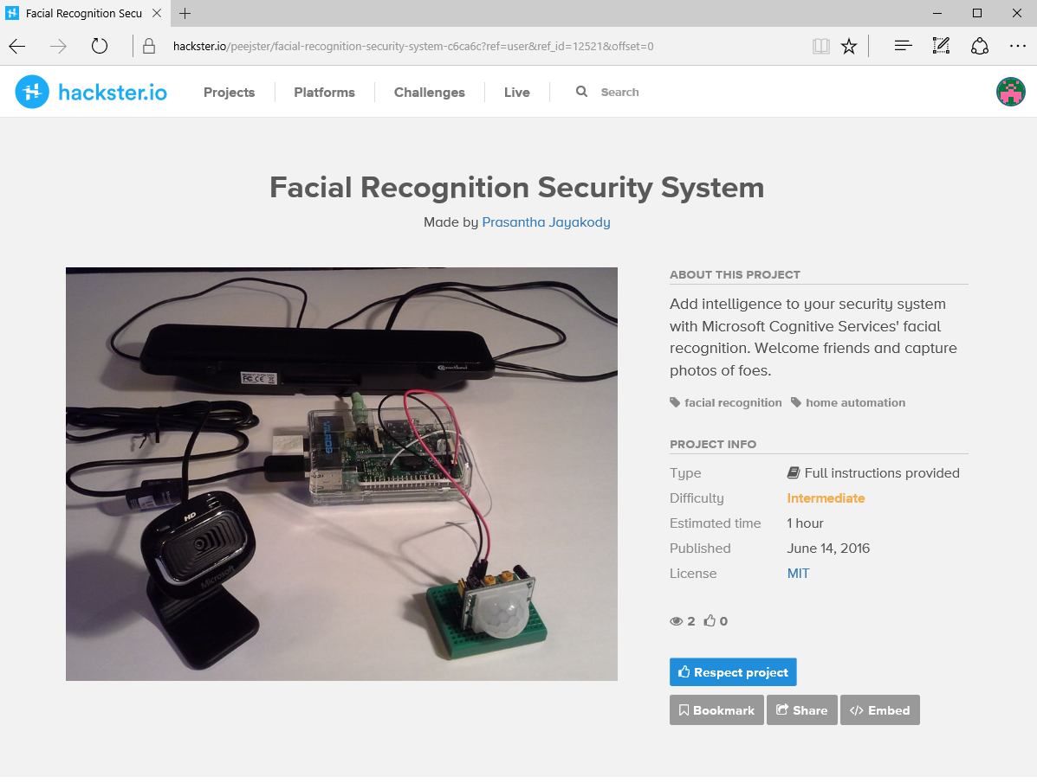
Build it yourself!
Full tutorial on hackster.IO (with a thousand other projects you can try…)
Notes:
The screenshot is clickable. It links away to the project page on Hackster. Step-by-step build instructions are provided along with a link to the source code in the GitHub repository.
Project Page: https://www.hackster.io/peejster/facial-recognition-security-system-c6ca6c
GitHub Repo: https://github.com/peejster/DormRoomMonitor

Slide 26
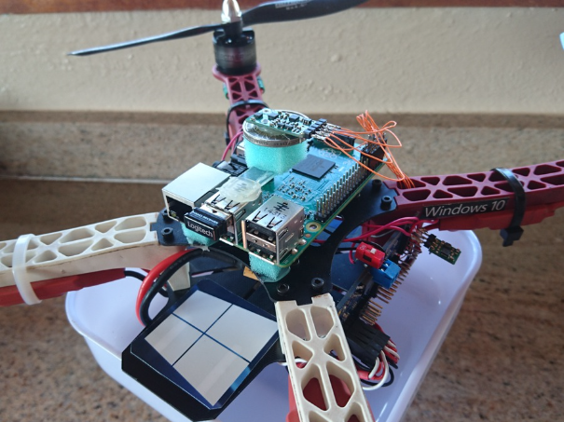
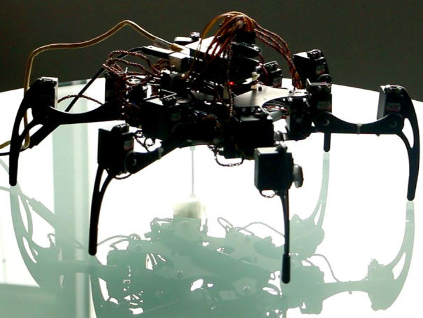
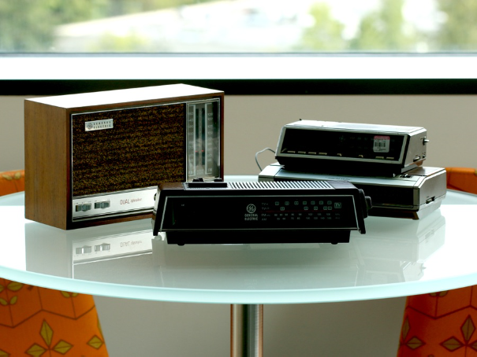

What’s next?
Hack-it and make the Intelligent Security System your own.
Experiment with other projects using Azure, Cognitive Services, and Windows.
Join a Maker community or your local Microsoft Student Partners group
Form a team and enter an Intelligent project in the Imagine Cup.
Notes:
The Dorm Room Monitor project is not the end goal; it’s just a starting point. There are lots and lots of modifications and improvements that can be made. For example, I want to take lots of pictures and save them when an intruder is detected. And since we have an interrupt on the sensor pin and can tell the difference between someone entering (the pin goes from low to high) and someone existing (the pin goes from high to low), we can keep taking pictures until the intruder leaves. I would also like to add the speaker recognition service (another Microsoft Cognitive service) as a back up authentication method in case the facial recognition doesn’t get a good picture of the person when he/she enters the room.
Maybe the Dorm Room Monitor project doesn’t excite you. Maybe you are into robotics. Maybe you are into environmental projects. Whatever is of interest, you are sure to find a project that can be a starting point online. For example, on Hackster.io, there are hundreds of fully documented projects using Windows and Azure.
One of the great things about making these sorts of projects is that you are never alone. There are lots of people out there that share your interests or who are even trying to do something similar. Become part of the community and learn from others and share your knowledge. Also, community involvement is not limited to online / the virtual world. You can also be part of a real world community here locally. For example, you can check out your campus’s Microsoft Student Partner group and see what they have going on.
Presenter: Each of the images represent a Windows and / or Azure project on Hackster. Each is clickable so that you can see what the project is about. You can also customize the slide with student projects, your projects, projects that are relevant to your geography, etc.

